Slide 1
The 8051 Microcontroller and Embedded Systems
CHAPTER 6
ARITHMETIC, LOGIC INSTRUCTIONS, AND PROGRAMS
vignan university

Slide 2
OBJECTIVES
Define the range of numbers possible in 8051 unsigned data
Code addition and subtraction instructions for unsigned data
Perform addition of BCD data
Code 8051 unsigned data multiplication and division instructions
Code 8051 Assembly language logic instructions AND, OR, and EX-OR
Use 8051 logic instructions for bit manipulation
Use compare and jump instructions for program control
Code 8051 rotate instruction and data serialization
Explain the BCD (binary coded decimal) system of data representation
Contrast and compare packed and unpacked BCD data
Code 8051 programs for ASCII and BCD data conversion
Code 8051 programs to create and test the checksum byte
vignan university

Slide 3
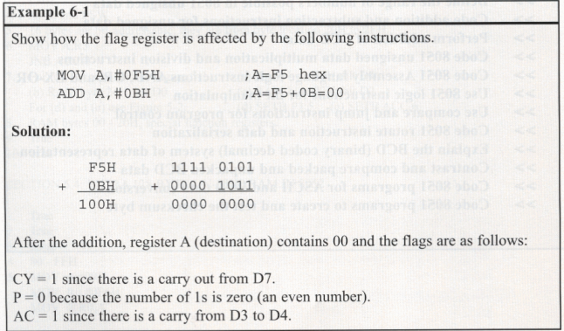
Addition of unsigned numbers
The form of the ADD instruction is
    ADD A, source ;A = A + source
vignan university

Slide 4
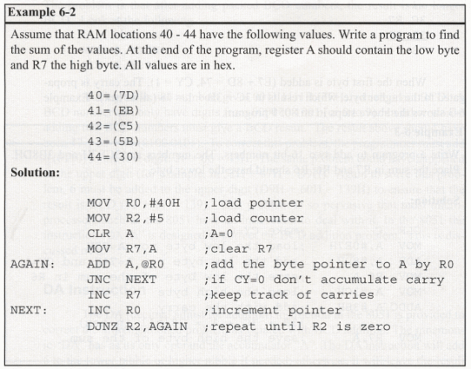
Addition of individual bytes
vignan university

Slide 5
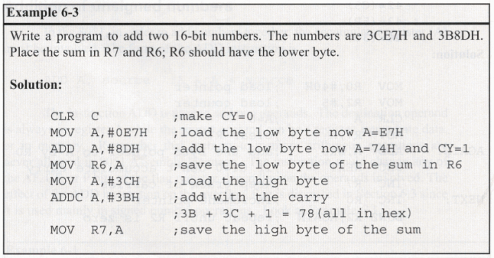
ADDC and addition of 16-bit numbers
vignan university

Slide 6
BCD (binary coded decimal) number system
Unpacked BCD
  The lower 4 bits of the number represent the BCD number.
  The rest of the bits are 0.
  For example, "0000 1001" and "0000 0101" are unpacked BCD for 9 and 5, respectively.
  Unpacked BCD requires 1 byte of memory or an 8-bit register to contain it.
vignan university

Slide 7
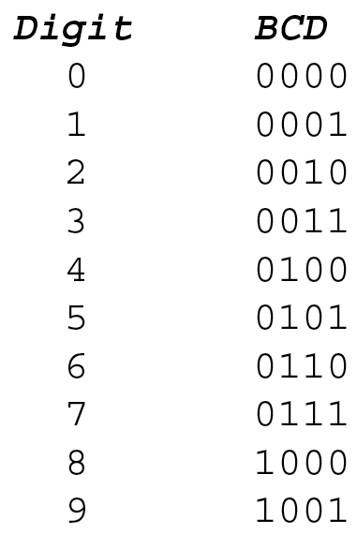
SECTION 6.1: ARITHMETIC INSTRUCTIONS
Unpacked BCD
Figure 6–1 BCD Code
vignan university

Slide 8
BCD (binary coded decimal) number system
Packed BCD
  A single byte has two BCD numbers in it, one in the lower 4 bits, and one in the upper 4 bits.
  For example, "0101 1001" is packed BCD for 59H.
  It takes only 1 byte of memory to store the packed BCD operands.
  Its more efficient than unpacked BCD.
vignan university

Slide 9
BCD (binary coded decimal) number system
There is a problem with adding BCD numbers.
Adding two BCD numbers must give a BCD result.
After adding packed BCD numbers, the result is no longer BCD.
  MOV A, #17BCD
  ADD A,#28BCD ;A = 3F which is not BCD
  ;should be 17 + 28 = 45BCD
  "DA A" is designed to correct the BCD addition problem.
vignan university

Slide 10
BCD (binary coded decimal) number system
DA instruction
  MOV A,#47H ;A=47H first BCD operand
  MOV B,#25H ;B=25 second BCD operand
  ADD A,B ;hex (binary) addition (A=6CH)
  DA A ;adjust for BCD addition (A=72H)
DA A must be used after the addition of BCD operands.
Important to note that DA A works only after an ADD instruction, it will not work after the INC instruction.
vignan university

Slide 11
Subtraction of unsigned numbers
SUBB A, source ;A = A - source – CY
In the 8051 we have only have subtract with borrow SUBB.
There are two cases for the SUBB instruction:
  (1) with CY = 0
  (2) with CY = l
vignan university

Slide 12
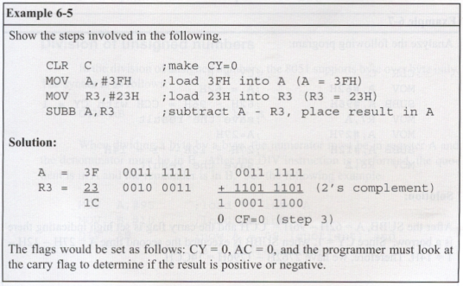
Subtraction of unsigned numbers
vignan university

Slide 13
Subtraction of unsigned numbers
If the CY = 0 after the execution of SUBB, the result is positive.
If CY = 1, the result is negative and the destination has the 2's complement of the result.
Normally, the result is left in 2's complement, but the CPL (complement) and INC instructions can be used to change it.
The CPL instruction performs the 1's complement of the operand; then the operand is incremented (INC) to get the 2's complement.
vignan university

Slide 14
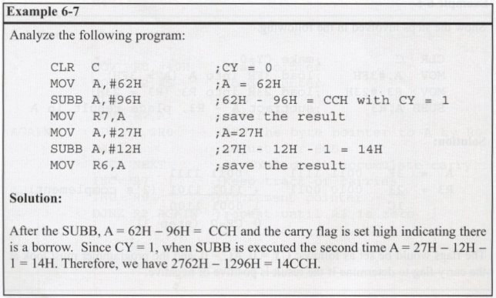
Subtraction of unsigned numbers
SUBB (subtract with borrow) when CY = 1
vignan university

Slide 15
UNSIGNED MULTIPLICATION AND DIVISION
In multiplying or dividing two numbers in the 8051, the use of registers A and B is required.
The multiplication and division instructions work only with these two registers.
vignan university

Slide 16
Multiplication of unsigned numbers
The 8051 supports byte-by-byte multiplication only.
The bytes are assumed to be unsigned data. MUL AB ;A x B, place 16-bit result in B and A
After multiplication, the result is in the A and B registers.
The lower byte is in A, and the upper byte is in B.
  MOV A,#25H ;load 25H to reg. A
  MOV B,#65H ;load 65H in reg. B
  MUL AB ;25H * 65H = E99 where
  ;B = 0EH and A = 99H
vignan university

Slide 17

Multiplication of unsigned numbers
Table 6–1 Unsigned Multiplication Summary (MUL AB)
vignan university

Slide 18
Division of unsigned numbers
In the division of unsigned numbers, the 8051 supports byte over byte only.
  DIV AB ;divide A by B
The numerator must be in register A and the denominator must be in B.
After the DIV instruction is performed, the quotient is in A and the remainder is in B.
vignan university

Slide 19
Division of unsigned numbers
MOV A,#95 ;load 95 into A
MOV B,#10 ;load 10 into B
DIV AB ;now A = 09 (quotient) and
        ;B = 05 (remainder)
This instruction always makes CY = 0 and OV = 0 if the denominator is not 0.
If the denominator is 0 (B = 0), OV = 1 indicates an error, and CY = 0.
The standard practice in all microprocessors when dividing a number by 0 is to indicate in some way the invalid result of infinity.
In the 805 I, the OV flag is set to 1.
vignan university

Slide 20
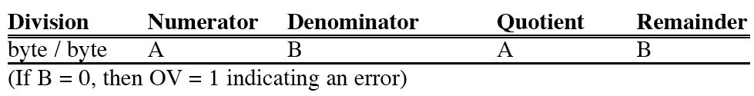
Division of unsigned numbers
Table 6–2 Unsigned Division Summary (DIV AB)
vignan university

Slide 21
SECTION 6.2: SIGNED NUMBER CONCEPTS AND ARITHMETIC OPERATIONS
Concept of signed numbers in computers
  Computers must be able to accommodate sign numbers.
  Computer scientists have devised the following arrangement for the representation of signed positive and negative numbers:
    The most significant bit (MSB) is set aside for the sign (+ or -), while the rest of the bits are used for the magnitude.
    The sign is represented by 0 for positive (+) numbers and 1 for negative (- ) numbers.
vignan university

Slide 22
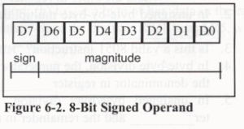
Signed 8-bit operands
In signed byte operands, D7 (MSB) is the sign and D0 to D6 are set aside for the magnitude of the number.
If D7 = 0, the operand is positive, and if D7 = 1, it is negative.
vignan university

Slide 23
Positive numbers
The range of positive numbers that can be represented is 0 to +127.
If a positive number is larger than +127, a 16-bit size operand must be used.
vignan university

Slide 24
Negative numbers
For negative numbers, D7 is1.
The magnitude is represented in its 2's complement.
To convert to negative number representation (2's complement):
  1. Write the magnitude of the number in 8-bit binary (no sign).
  2. Invert each bit.
  3. Add 1 to it.
vignan university

Slide 25
Overflow problem in signed number operations
When using signed numbers, a serious problem arises that must be dealt with. This is the overflow problem.
The 8051 indicates the existence of an error by raising the OV (overflow) flag.
If the result of an operation on signed numbers is too large for the register, an overflow has occurred and the programmer must be notified.
vignan university

Slide 26
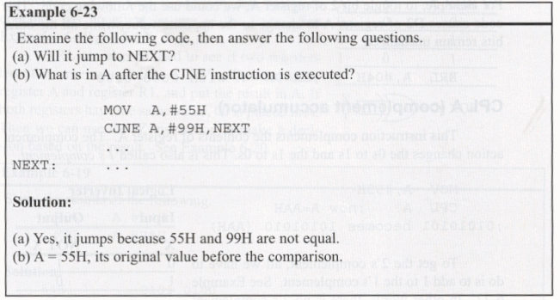
Compare instruction
CJNE destination,source,relative address
vignan university

Slide 27
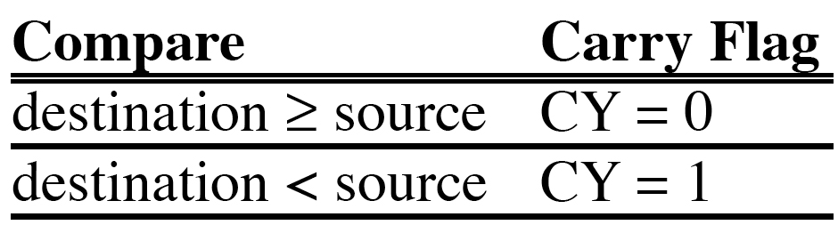
SECTION 6.3: LOGIC AND COMPARE INSTRUCTIONS
Compare instruction
Table 6–3 Carry Flag Setting For CJNE Instruction
vignan university

Slide 28
SECTION 6.4: ROTATE INSTRUCTION AND DATA SERIALIZATION
Rotating through the carry
  In the 8051 the rotation instructions RL, RR, RLC, and RRC are designed to rotate the accumulator right or left.
  To rotate a byte the operand must be in register A.
  There are two type of rotations. One is a simple rotation of the bits of A, and the other is a rotation through the carry.
vignan university

Slide 29
Serializing data
Serializing data is a way of sending a byte of data one bit at a time through a single pin of microcontroller.
There are two ways to transfer a byte of data serially:
  1. Using the serial port. The details of serial port data transfer are discussed in Chapter 10.
  2. The second method of serializing data is to transfer data one bit at a time and control the sequence of data and spaces in between them.
In many new devices such as LCD, ADC, and ROM, the serial versions of these devices are becoming popular since they take less space on a printed circuit board.
vignan university

Slide 30
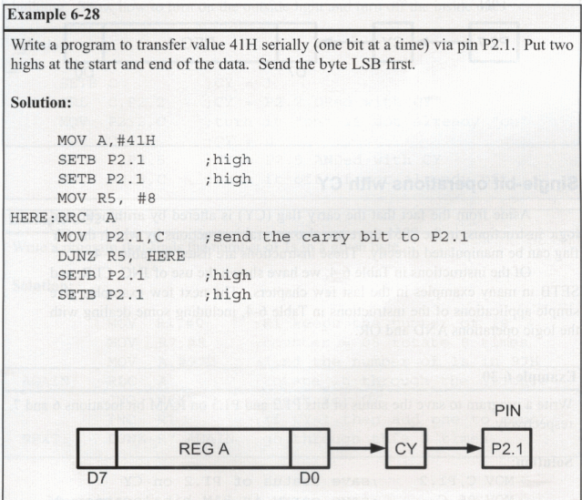
Serializing a byte of data
vignan university

Slide 31
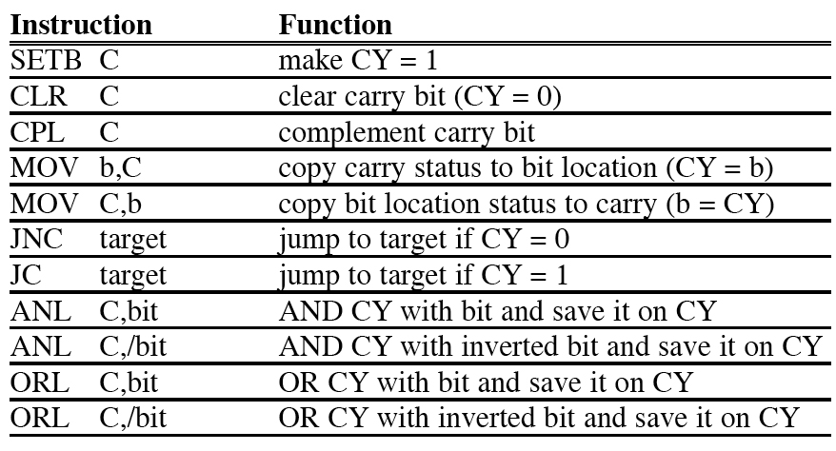
Single-bit operations with CY
vignan university
Table 6–4 Carry Bit-Related Instructions

Slide 32
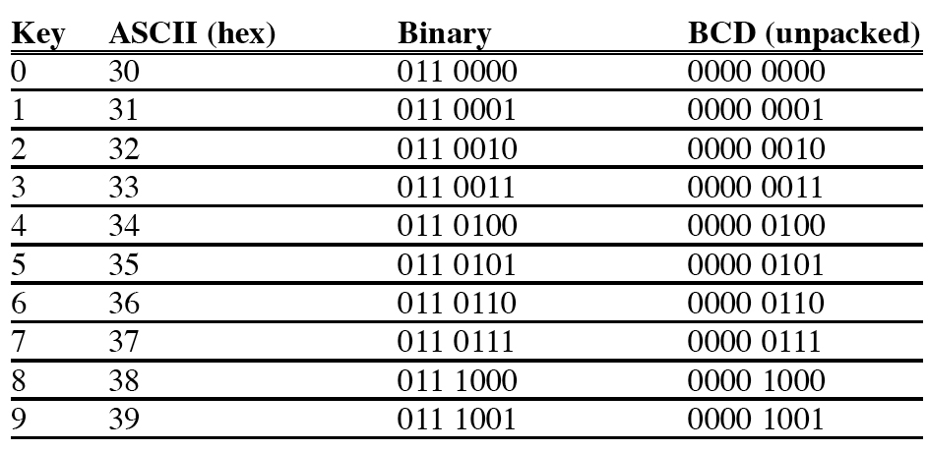
ASCII numbers
vignan university
Table 6–5 ASCII Code for Digits 0–9

Slide 33
Checksum byte in ROM
To ensure the integrity of the ROM contents, every system must perform the checksum calculation.
The process of checksum will detect any corruption of the contents of ROM.
The checksum byte is an extra byte that is tagged to the end of a series of bytes of data.
To calculate the checksum byte of a series of bytes of data, the following steps can be taken:
  1. Add the bytes together and drop the carries.
  2. Take the 2's complement of the total sum; this is the checksum byte, which becomes the last byte of the series.
vignan university

Slide 34
Checksum byte in ROM
To perform the checksum operation, add all the bytes, including the check­sum byte.
The result must be zero.
If it is not zero, one or more bytes of data have been changed (corrupted).
vignan university

Slide 35
Next …
Lecture Problems Textbook Chapter 6
  Answer as many questions as you can and submit via MeL before the end of the lecture.
Proteus Exercise 6
  Do as much of the Proteus exercise as you can and submit via MeL before the end of the lecture.
vignan university

